Slide 1



Sudoku Solver Visualizer
Welcome to the Sudoku Solver Visualizer! This interactive tool will demonstrate how a backtracking algorithm solves Sudoku puzzles.
Name:- Renu Kumari
Reg No :- 12207650

Slide 2

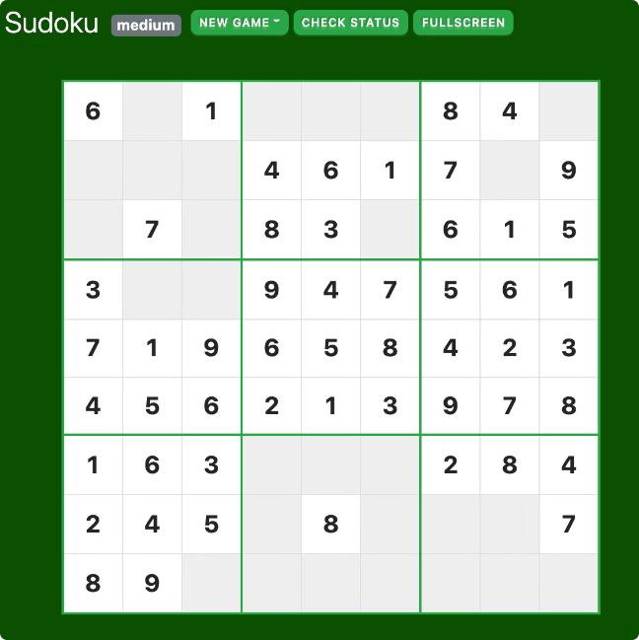
Introduction to Sudoku
Sudoku is a logic-based number-placement puzzle. The objective is to fill a 9x9 grid with digits so that each column, each row, and each of the nine 3x3 subgrids contains all of the digits from 1 to 9.
1
Objective
Fill the grid with digits 1-9, ensuring each row, column, and 3x3 square has all digits.
2
Constraints
Each digit appears only once in each row, column, and 3x3 square.
3
Difficulty Levels
Varying levels of difficulty exist, from easy to expert.

Slide 3
Sudoku Solving Techniques
Several techniques can be used to solve Sudoku puzzles, including elimination, hidden singles, and naked pairs.
Elimination
Hidden Singles
Naked Pairs
If a digit already exists in a row, column, or 3x3 square, it cannot be placed in that same row, column, or square.
If a specific digit is the only possible candidate in a specific cell, it must be placed in that cell.
When two cells in a row, column, or 3x3 square have only two possible candidates, those candidates can be eliminated from other cells in that row, column, or square.

Slide 4

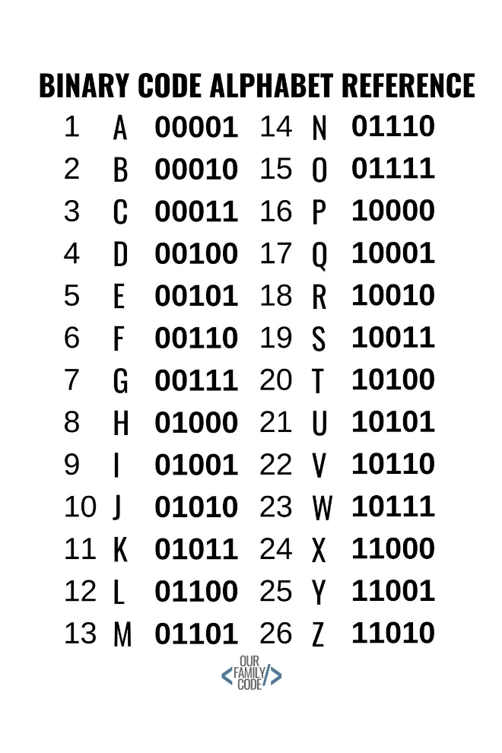
Backtracking Algorithm
The backtracking algorithm is a systematic way of trying different possibilities until a solution is found. It involves exploring branches of possibilities and backtracking when a wrong choice is made.
1
Initialization
Start with an empty grid. The algorithm starts with the first empty cell.
2
Recursive Step
Try placing each digit from 1 to 9 in the current cell. If a digit is valid, move to the next empty cell.
3
Backtracking
If no valid digit can be placed in the current cell, backtrack to the previous cell and try a different digit. This process continues until a solution is found.

Slide 5


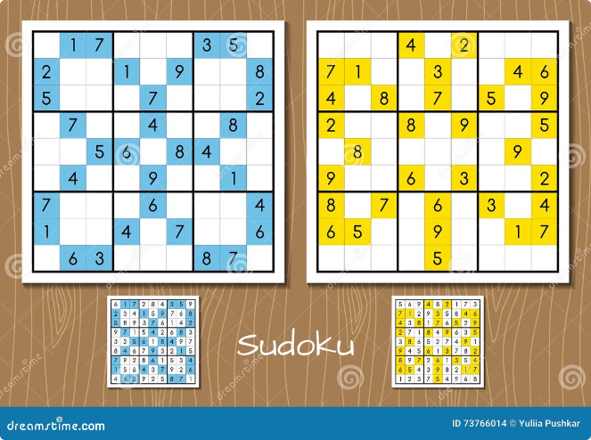



Visualization of Solving Process
Our visualizer will highlight the steps the algorithm takes in solving a Sudoku puzzle. It will show the candidate digits for each cell and how they are eliminated as the algorithm progresses.
Initial Grid
The initial Sudoku puzzle is displayed with empty cells.
Candidate Digits
The algorithm considers possible digits for each empty cell. These candidate digits are displayed.
Placement
A valid digit is chosen and placed in the current cell. The candidate digits are updated.
Solution
The algorithm continues until all cells are filled, resulting in a complete and valid Sudoku solution.

Slide 6


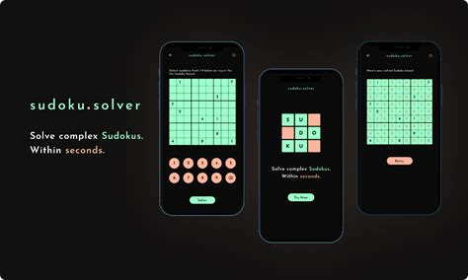



Step-by-Step Walkthrough
Our visualizer will walk you through the backtracking algorithm step-by-step. You can control the speed of the process and observe the changes as the algorithm progresses.
Play
Start the visualization and watch the algorithm solve the puzzle in real-time.
Pause
Pause the visualization at any point to examine the current state of the algorithm.
Step Forward
Advance the visualization step-by-step to carefully observe each decision made by the algorithm.
Rewind
Go back to previous steps to review the algorithm's reasoning.

Slide 7

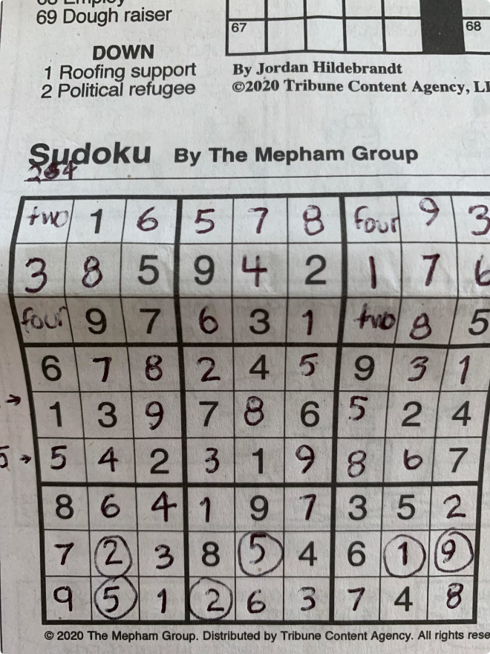
Handling Invalid Sudoku Puzzles
The visualizer can also handle invalid Sudoku puzzles. It will identify any errors or inconsistencies in the initial puzzle and display an appropriate message.
Error Type
Description
Duplicate Digits
If a digit appears more than once in a row, column, or 3x3 square, the puzzle is invalid.
Missing Digits
If a row, column, or 3x3 square is missing a digit, the puzzle is incomplete and may not have a solution.
Impossible Combinations
Sometimes, the initial puzzle contains impossible combinations of digits that make it unsolvable.

Slide 8

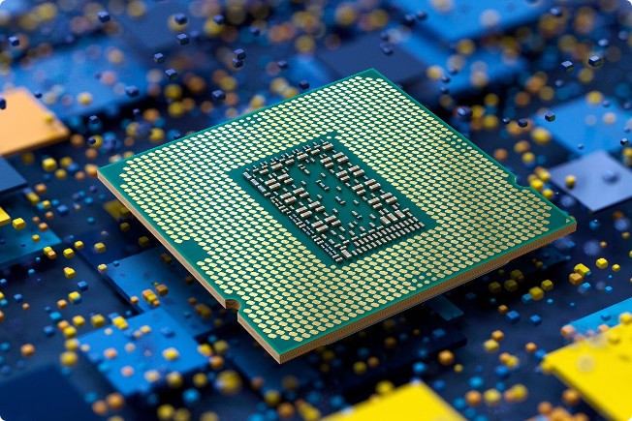
Performance Optimization
The backtracking algorithm can be optimized to improve its performance. The visualizer will demonstrate techniques like constraint propagation and heuristics.
Constraint Propagation
As the algorithm places digits, it can eliminate candidate digits from other cells, reducing the search space. This can significantly speed up the solving process.
Heuristics
Heuristics are rules of thumb that can guide the algorithm toward promising choices. For example, the algorithm could prioritize cells with fewer candidate digits. This can help avoid unnecessary exploration of less likely branches.

Slide 9


User Interface Design
The user interface is designed for ease of use and to provide a clear and engaging visualization of the solving process. It features a clean and modern design with intuitive controls.
1
Input Puzzle
A user-friendly interface allows you to enter your Sudoku puzzle or choose from a set of pre-defined puzzles.
2
Visualization Controls
Buttons for play, pause, step forward, rewind, and speed control allow you to interact with the visualization.
3
Visual Feedback
Clear visual feedback is provided throughout the solving process, highlighting candidate digits, placed digits, and any errors.
4
Solution Display
Once the puzzle is solved, the complete solution is displayed with the steps taken by the algorithm.

Slide 10

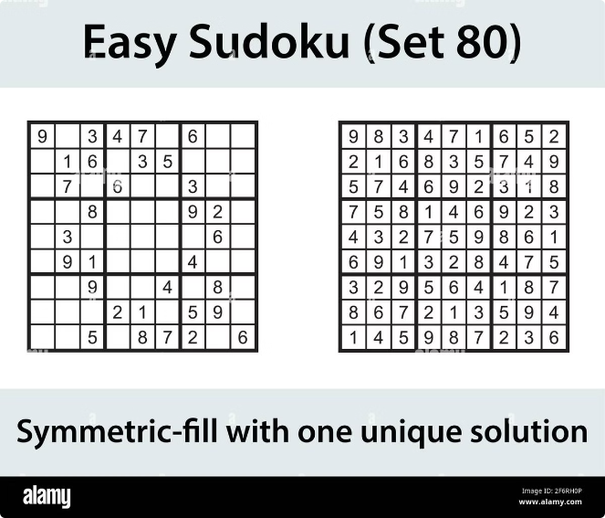
Conclusion and Future Enhancements
This visualizer provides a comprehensive and interactive experience of the backtracking algorithm applied to Sudoku puzzles. Future enhancements could include more advanced optimization techniques, different Sudoku puzzle variations, and additional features to enhance user engagement.
1
Advanced Optimization
Implementing more sophisticated techniques like constraint propagation and heuristics to further improve performance.
2
Puzzle Variations
Expanding the visualizer to support different variations of Sudoku, such as killer Sudoku or Sudoku X.
3
Interactive Features
Adding interactive elements to allow users to engage more actively with the solving process, such as letting them make guesses or try their own strategies.

